Slide 1


AWS Lambda
Event-Driven Code for Devices and the Cloud
Olivier Klein 奧樂凱
Senior Solutions Architect, AWS
1st September 2016

Slide 2
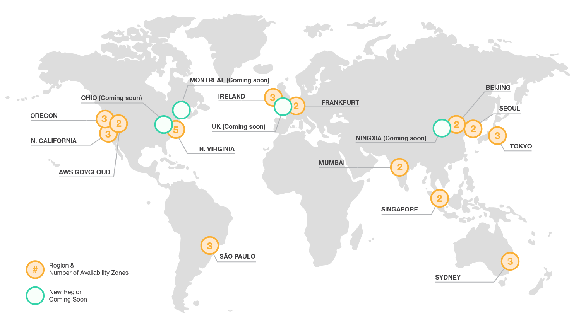
AWS Global Infrastructure
13 Regions
35 Availability Zones
59 Edge Locations
Continuous Expansion

Slide 3

AWS Global Infrastructure
13 Regions
35 Availability Zones
59 Edge Locations
Continuous Expansion
New!
New!

Slide 4



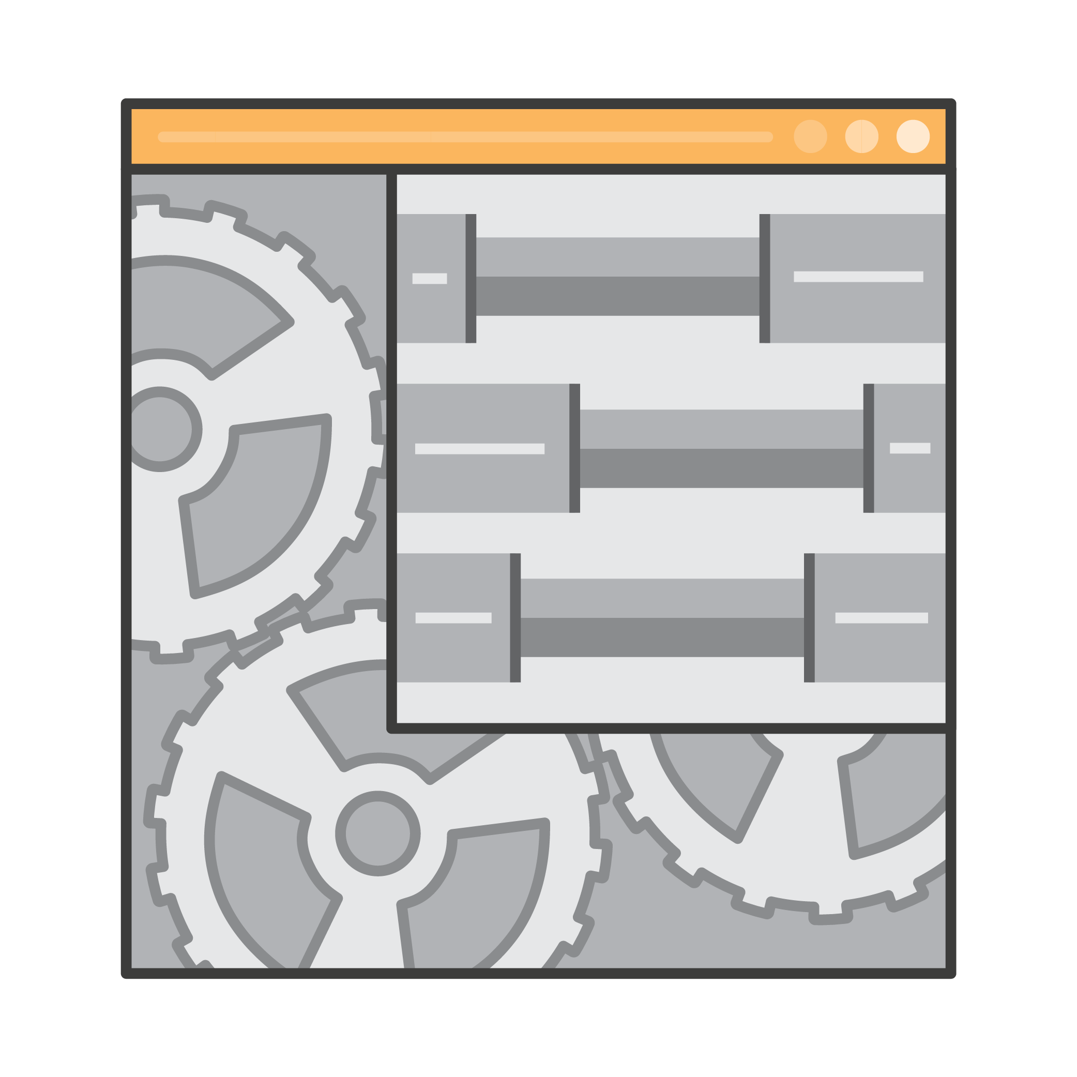


AWS Lambda
“Run your code highly-available in the cloud in response to events and scale without any servers to manage”
Zero Administration
Auto Scaling
Your Own Code
Focus on business logic, not infrastructure.
Lambda scales the infrastructure to match the event rate
Write your own code in JavaScript, Java or Python

Slide 5


No Infrastructure to Manage
Focus on business logic, not infrastructure
Upload your code; AWS Lambda handles
Capacity
Scaling
Deployment
Monitoring
Logging
Web service front end
Security patching

Slide 6

Automatic Scaling
Lambda scales to match the event rate
Don’t worry about over or under provisioning
Pay only for what you use
New app or successful app, Lambda matches your scale

Slide 7

Fine-Grained Pricing
Compute time in 100ms increments
Low request charge
No hourly, daily or monthly minimums
No per-device fees
Never pay for idle!
Free Tier
1M requests and 400,000 GBs of compute.
Every month, every customer.

Slide 8





AWS Lambda – Event Driven Compute
Stateless code called Lambda functions
Invoke Lambda functions straight from your browser or even your mobile app
Trigger functions by events (state transitions) in other services:
New file in S3
New item in DynamoDB
New message in your Kinesis stream
Amazon S3
Amazon DynamoDB
Amazon Kinesis
AWS Lambda

Slide 9



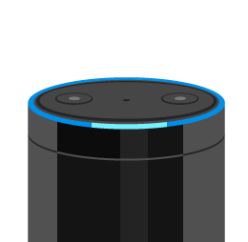





Event Sources that integrate with AWS Lambda
DATA STORES
ENDPOINTS
Amazon S3
Amazon DynamoDB
Amazon Kinesis
Amazon Cognito
Amazon Alexa
Amazon API Gateway
AWS IoT
… and the list continues to grow.
REPOSITORIES
EVENT/MESSAGE SERVICES
AWS CloudFormation
AWS CloudTrail
Amazon CloudWatch
Amazon Config
Amazon SES
Amazon SNS
Cron events

Slide 10







Multiple Application Types using AWS Lambda
Analytics
Operational management
Live Dashboards
Data workflows
Content management
ETL workflows
Interactive Backends
Bots
Webhooks
Autonomous IT
Policy engines
Infrastructure management

Slide 11
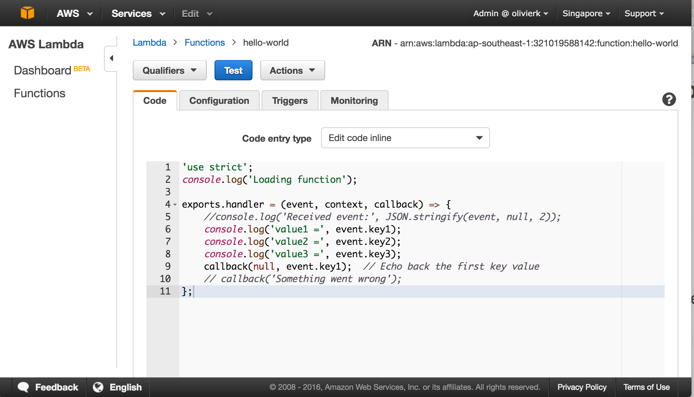
Hello World!
DEMO

Slide 12

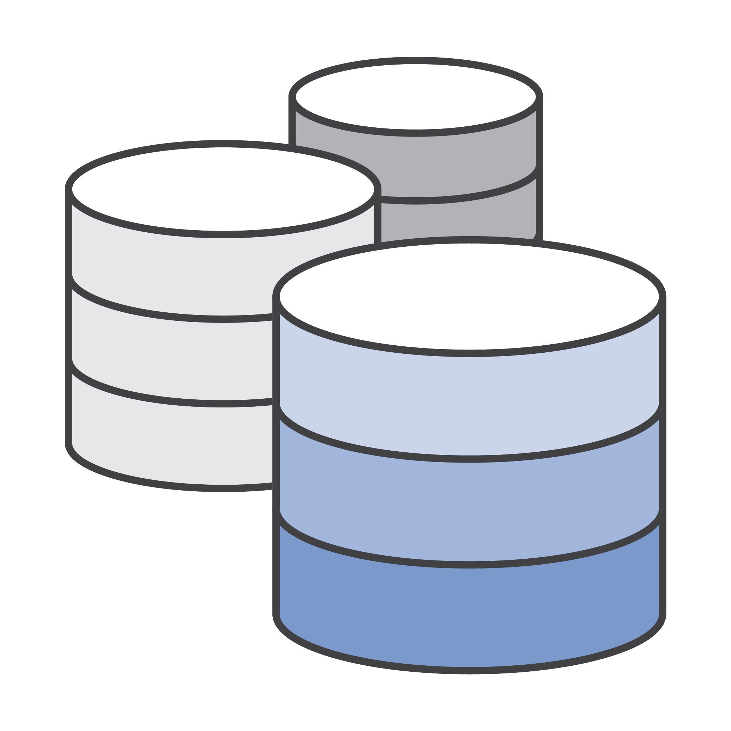
How to build application backends?
Mobile
Back-end logic
Database

Slide 13

How to build application backends even better?
Microservice
Amazon API Gateway
AWS Lambda
Amazon DynamoDB

Slide 14



Amazon API Gateway
Fully managed and scalable RESTful API gateway service
Powered by our content delivery network via 59 global edge locations
Provides DDoS protection and throttling capabilities
Multiple API stages which you define (e.g. dev, test, prod)
AWS Lambda
Amazon EC2
Amazon API Gateway
AWS API
On-prem server

Slide 15



When to choose API Gateway vs. Direct SDK?
Amazon API Gateway adds an additional layer between your app users and your logic and data stores in order to:
Back-end logic can be interchanged without app modifications (important for native mobile app)
Ability to throttle individual users or requests
Protect against DDoS attacks including counterfeit requests (Layer 7) and SYN floods (Layer 3)
Provides a caching layer for your calls
Enables CORS for all AWS service for web apps

Slide 16
Introducing Chalice
Serverless micro-framework for AWS
Deploy APIs quickly via AWS Lambda and Amazon API Gateway
$ chalice new-project helloworld
$ cat helloworld/app.py
from chalice import Chalice
app = Chalice(app_name="helloworld")
@app.route("/")
def index():
return {"hello": "world"}
$ chalice deploy
...
Your app is available at: https://endpoint/dev
$ curl https://endpoint/dev
{"hello": "world"}
github.com/awslabs/chalice

Slide 17


Simple API with Chalice
DEMO
Python (Chalice)
Build / Deploy
Test
Amazon API Gateway
AWS Lambda
Postman

Slide 18




How to get the web app to the browser?
?

Slide 19

Storage and Delivery of the App
Amazon S3
Highly available object storage
Designed for 99.999999999% durability
Offers HTTP / HTTPS endpoint to objects
Amazon CloudFront
Content Delivery Network with 59 edge locations across the world
Caches content on edge locations for low latency
Amazon S3
Amazon CloudFront

Slide 20
Amazon S3
Amazon CloudFront
Browser

Slide 21




But Lambda is stateless, where to store data?

Slide 22
Amazon DynamoDB
Fully Managed NoSQL Database Service
Schemaless Data Model
Seamless scalability
No storage or throughput limits
Consistent low latency performance
High durability and availability
Replicated across 3 facilities
table
items
attributes
DynamoDB

Slide 23




Serverless App Architecture
Any other AWS Services (e.g. SNS, SES, ElastiCache etc.)
Amazon
CloudFront
Amazon
S3
Browser
Amazon API Gateway
AWS Lambda
Amazon
DynamoDB
JavaScript SDK

Slide 24
Serverless with AWS
DEMO
Amazon CloudFront
Amazon S3
Browser
Amazon API Gateway
AWS Lambda

Slide 25
Can I keep different versions of my Lambda function?

Slide 26
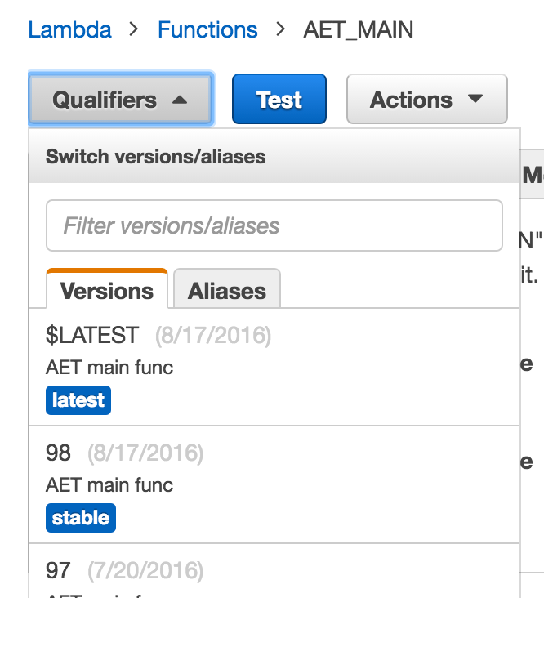
Versioning
Immutable versions of functions
Per version configuration
Per version Cloudwatch metrics
Cloudwatch Logs contain version attribute
Aliases to “label” a version release
$LATEST contains latest code

Slide 27
Update Alias to Deploy
$LATEST(95) | STABLE | TESTING
94 |  | V
93 | V
92

Slide 28
Update Alias to Deploy
$LATEST(95) | STABLE | TESTING
94 | V | V
93
92

Slide 29
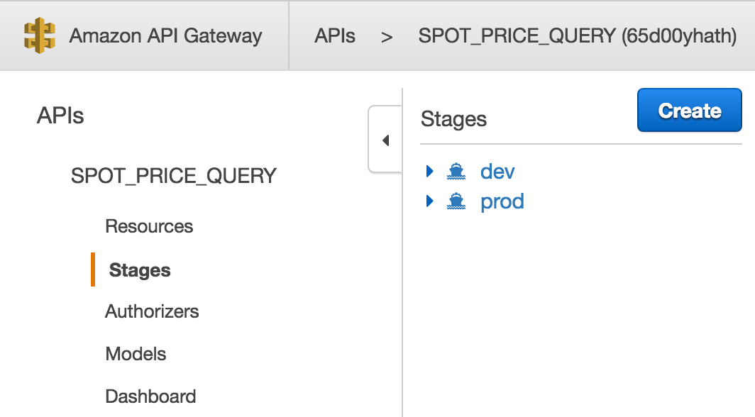
API Stages

Slide 30
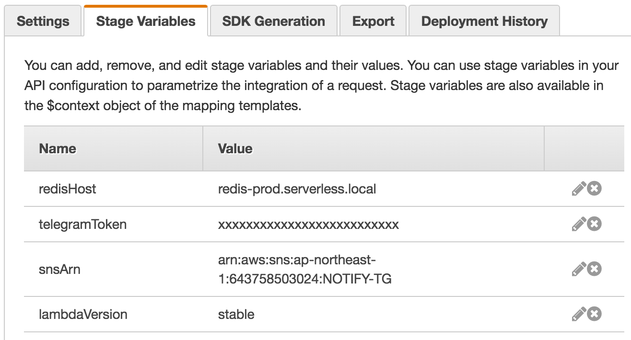
API Gateway Stage Variables

Slide 31
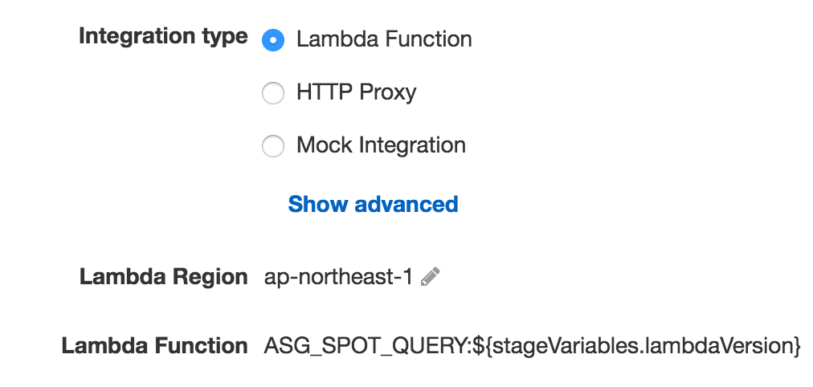
API Gateway Stage Variables

Slide 32
Pin your environment with stage variables
API Gateway | Lambda | Custom Domain
/prod/Resources | FunctionName:stable | https://api.example.com
/dev/Resources | FunctionName:$LATEST | https://dev.example.com
/qa/Resources | FunctionName:qa | https://qa.example.com

Slide 33
A few last Best Practices!

Slide 34
Best Practices for Lambda functions
Memory
CPU proportional to memory
Increasing =memory makes your code execute faster (if CPU bound)
Understand container re-use
Cold Start, Warm Start, Hot Start
If start time is crucial, create a scheduled function to keep the Lambda function “warm”
Timeout
Increasing timeout allows for longer functions, but more wait in case of errors
Be aware of safety throttles
AWS Lambda has a safety throttle of 100 concurrent function invocations
Can be raised to any limit via our support team

Slide 35
Thank you!
Olivier Klein 奧樂凱
Senior Solutions Architect, AWS
1st September 2016

